Slide 1


Slide 2

gfdsg
Clean Architecture with ASP.NET Core
Miroslav Popović Technical Manager @Qinshift https://miroslavpopovic.com/
https://github.com/miroslavpopovic/
https://www.linkedin.com/in/miroslavpopovic/
@miroslavpopovic

Slide 4
Agenda
Software Architecture
Templates
Demo
Pros/Cons
https://github.com/miroslavpopovic/clean-architecture-sample

Slide 5
Architecture

Slide 6
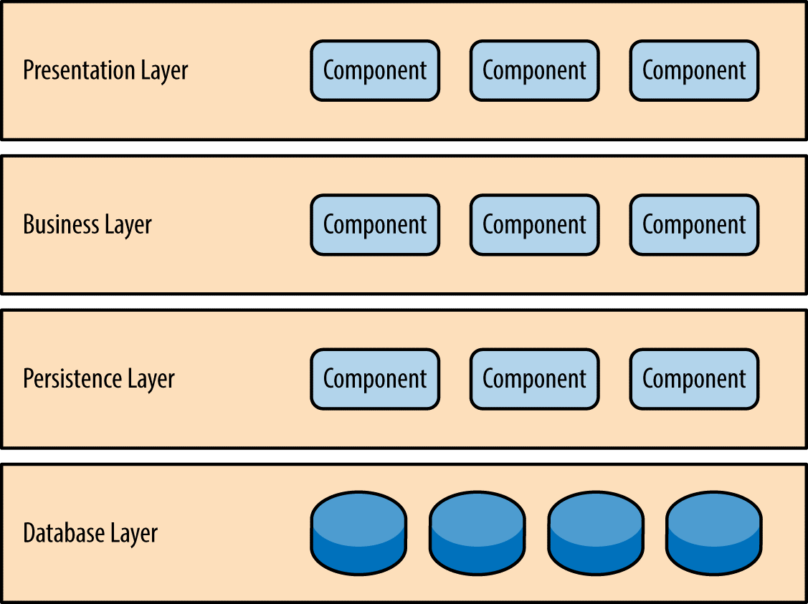
Layered Architecture
https://learning.oreilly.com/library/view/software-architecture-patterns/9781491971437/

Slide 7
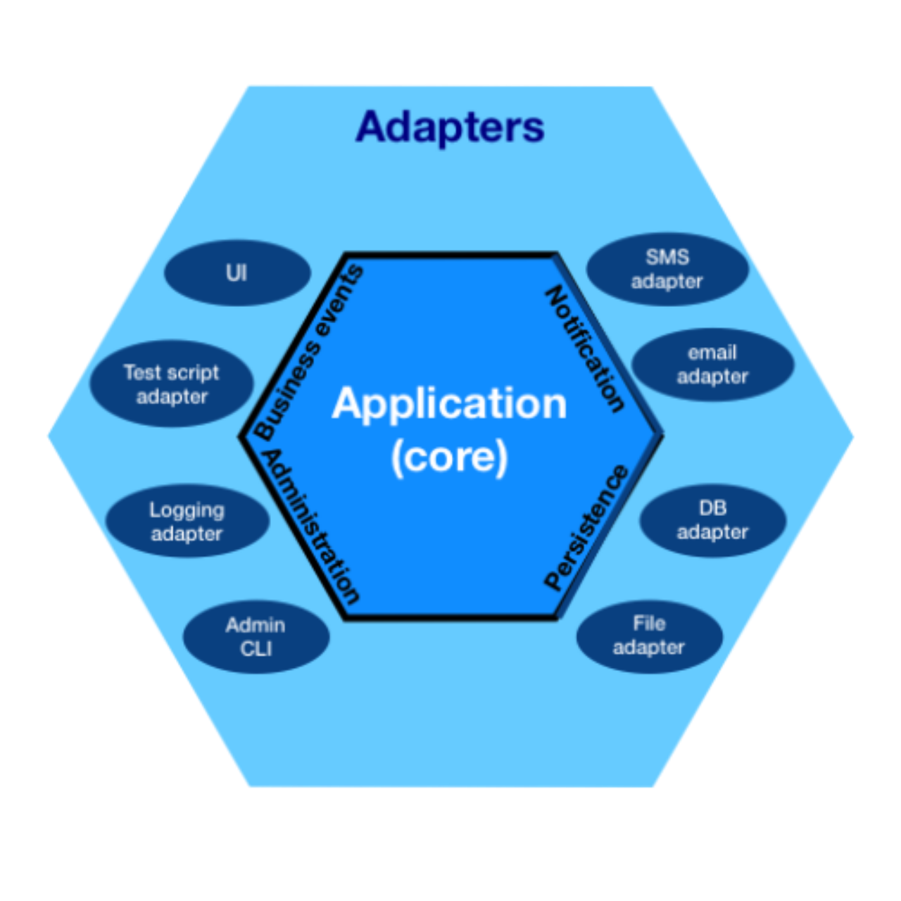
Hexagonal Architecture (Ports and Adapters)
https://alistair.cockburn.us/hexagonal-architecture/
Image credit: Cth027 - Own work, CC BY-SA 4.0, https://commons.wikimedia.org/w/index.php?curid=81276242

Slide 8
Onion Architecture
User Interface
Application Services
Domain Services
Domain Model
Infrastructure
Tests
https://jeffreypalermo.com/2008/07/the-onion-architecture-part-1/

Slide 9
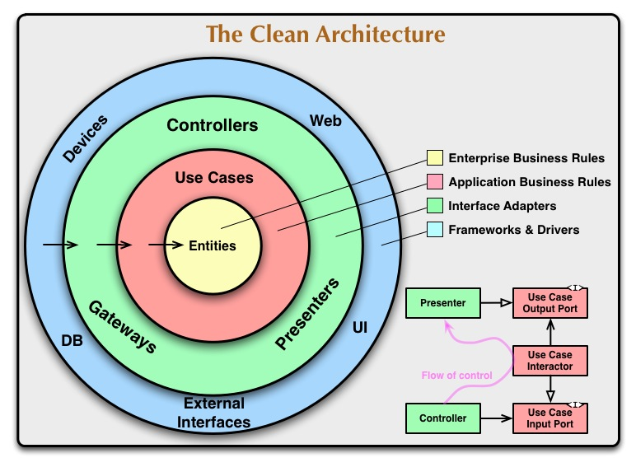
Clean Architecture
https://blog.cleancoder.com/uncle-bob/2012/08/13/the-clean-architecture.html

Slide 10
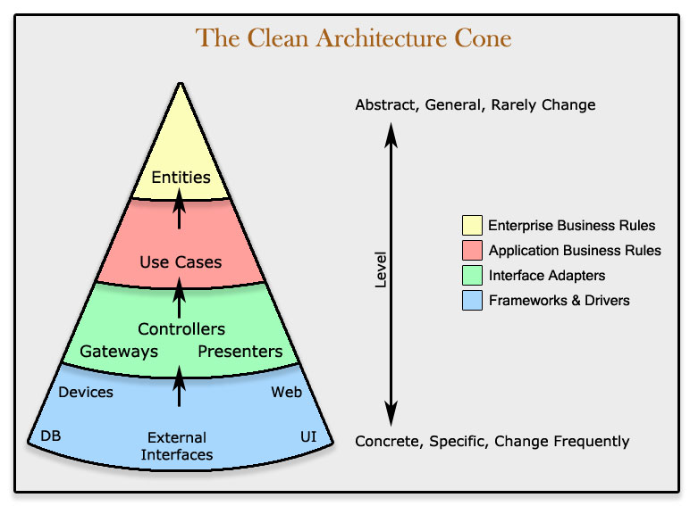
Clean Architecture
https://www.codingblocks.net/podcast/clean-architecture-make-your-architecture-scream/

Slide 11

Clean Architecture
https://www.amazon.com/Clean-Architecture-Craftsmans-Software-Structure/dp/0134494164/

Slide 12




Some Clean Architecture resources for .NET
Matthew Renze
https://www.milanjovanovic.tech/pragmatic-clean-architecture
https://www.pluralsight.com/courses/clean-architecture-patterns-practices-principles
https://dometrain.com/course/getting-started-clean-architecture-in-dotnet/
https://www.amazon.com/Clean-Architecture-net-Developer-Reference/dp/0138203288

Slide 13
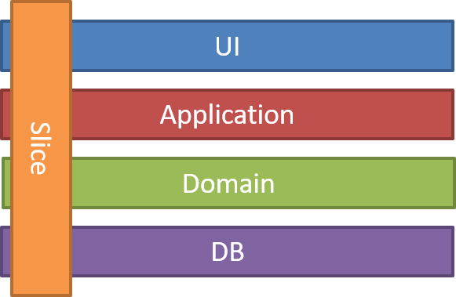
Vertical Slice Architecture
https://www.jimmybogard.com/vertical-slice-architecture/

Slide 14

Software Architecture styles
Monolithic
Layered architecture
Pipeline architecture
Microkernel architecture
Distributed
Service-based architecture
Event-driven architecture
Space-based architecture
Service-oriented architecture
Microservices architecture

Slide 15
Templates

Slide 16
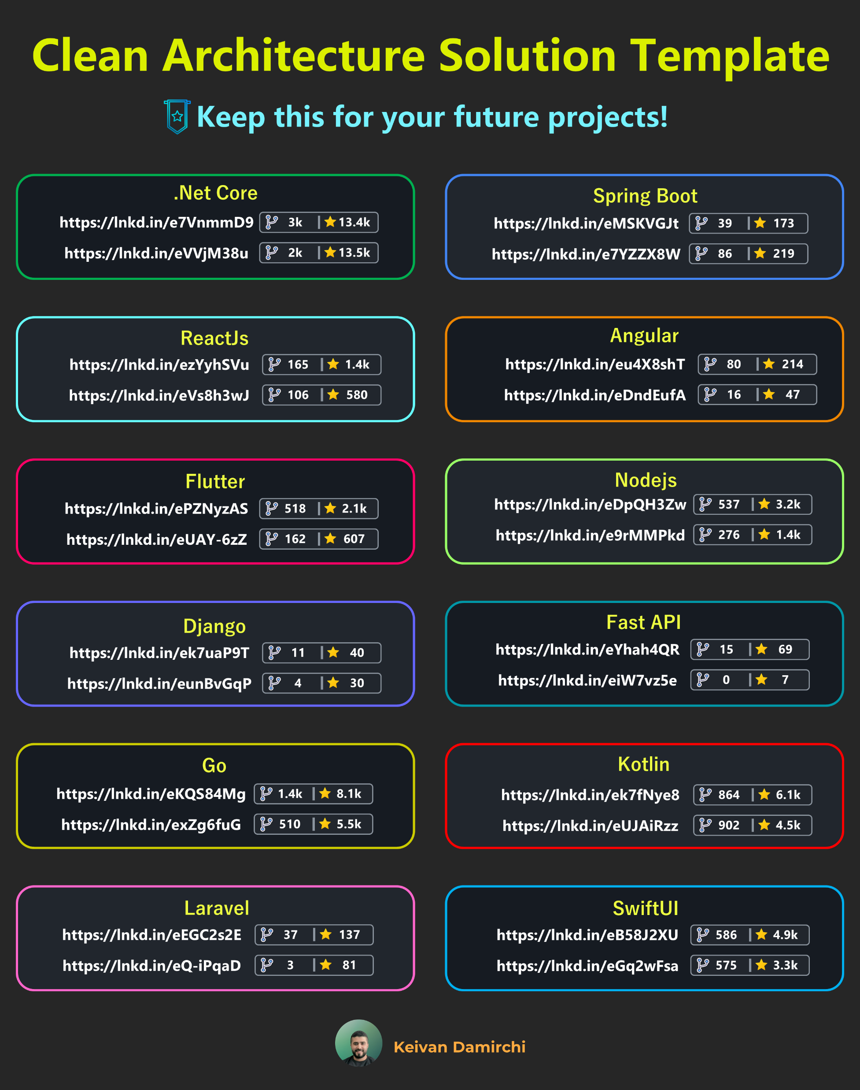
Templates for different platforms
https://github.com/kavaan/clean-architecture-solution-template/

Slide 17
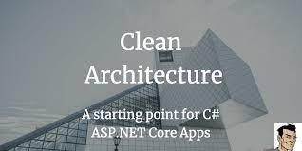
Clean Architecture by Steve Smith (Ardalis)
https://github.com/ardalis/CleanArchitecture
https://ardalis.com/aspnetcore-clean-architecture-template-version-8/

Slide 18
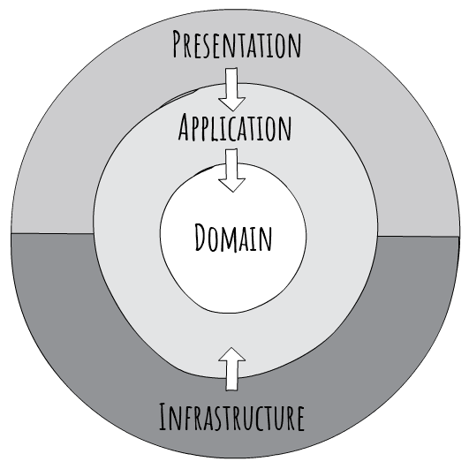
Clean Architecture by Jason Taylor
https://github.com/jasontaylordev/CleanArchitecture
https://jasontaylor.dev/clean-architecture-getting-started/

Slide 19
Demo

Slide 20
Jason Taylor’s Clean Architecture Template
Implementation of Clean Architecture using latest .NET
dotnet new ca-sln
SQL Server or SQLite out of box
Angular, React, or Web API template
ASP.NET Core Identity, using new APIs
CI/CD pipeline as Bicep code (GitHub Actions and Azure deployment)

Slide 21
Features
Domain
Base entities, domain events pattern, auditable entities, value objects…
Application
MediatR handlers and behaviors, Fluent Validation, AutoMapper mappings, basic exceptions, interfaces for infrastructure (db, user, identity), base models (lookup, result, pagination), authorization, domain event handlers, DI registrations
Infrastructure
EF Core persistence, entity type configurations, db migrations, auditable interceptor, domain entities interceptor, identity implementation, DI registrations
Web
Custom exception handler, route convention extensions, current user service implementation, endpoints, DI registrations
Tests
Domain unit tests, application unit tests, application functional tests using NUnit, Moq, FluentAssertions, Respawn and Test Containers

Slide 22
Modifications
Use latest C# constructs – primary constructors
Use build artifacts folder
Update all NuGet packages to latest version
Fix warnings and hints
Switch from NSwag to Swashbuckle
Replace custom routing conventions
Not enough flexibility for Swagger docs
Optionally – use Carter
Add API versioning support
Simplify application structure if no CQRS is used
Add Email service

Slide 23
Closing words

Slide 24
Pros
Business logic separation
No external dependencies in Core (Domain + Application)
Easy to grasp patterns
UI layer simplification
Testability
Templates with good infrastructure code to simplify development

Slide 25
Cons and tradeoffs
Technical layers (not business ones)
Domain, Infrastructure, Application, UI
Business logic modification (vertical) usually forces change in all layers
Can lead less experience developers into creating anemic domain models
The question of multiple UI layers
i.e., backend for frontend API, plus integration API
Code sharing with multiple projects
Is authorization behavior the right place for auth policies?

Slide 26
References
The Clean Architecture post by Robert C. Martin
Fundamentals of Software Architecture by Mark Richards, Neal Ford
Clean Architecture & DDD Series by Milan Jovanović
Clean Architecture with .NET Core: Getting Started by Jason Taylor
Clean Architecture Solution Template by Jason Taylor
Vertical Slice Architecture, not Layers! by Derek Comartin (CodeOpinion)
Vertical Slice Architecture by Milan Jovanović

Slide 27

Miroslav Popović https://miroslavpopovic.com/
https://github.com/miroslavpopovic/ https://www.linkedin.com/in/miroslavpopovic/
@miroslavpopovic
https://github.com/miroslavpopovic/clean-architecture-sample
Thank you! Questions?

